Slide 1
Naïve Bayes Classifier
Ying shen
Sse, tongji university
Sep. 2016

Slide 2
Background
There are two methods to establish a classifier
a) Model a classification rule directly
Examples: k-NN, decision trees, BP neural network, SVM
b) Make a probabilistic model of data within each class
Examples: naive Bayes, model based classifiers
a) are examples of discriminative classification
b) is an example of generative classification

Slide 3
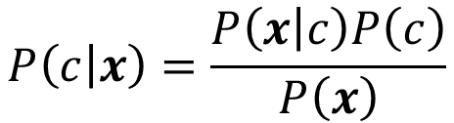
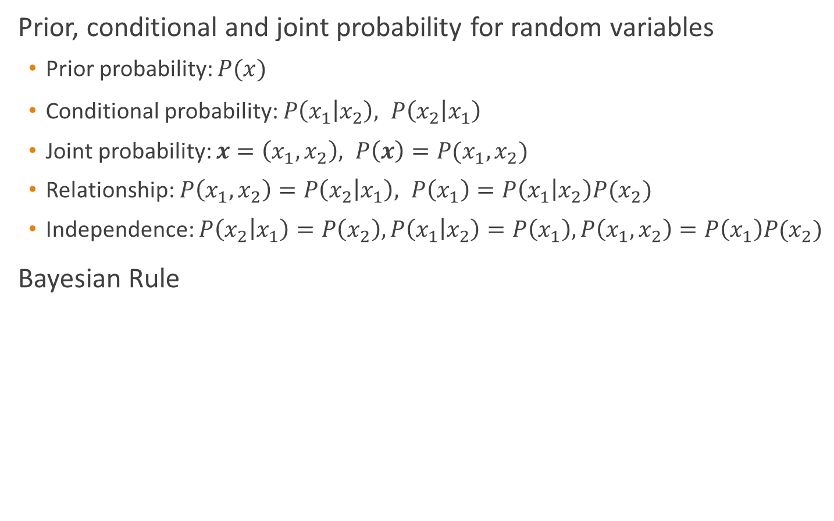
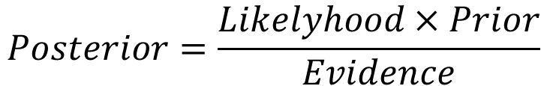
Probability Basics
Prior, conditional and joint probability for random variables
Prior probability: $P(x)$
Conditional probability: $P\left(x_{1} | x_{2}\right), P\left(x_{2} | x_{1}\right)$
Joint probability: $x=\left(x_{1},x_{2}\right), P\left(x\right)=P(x_{1},x_{2})$
Relationship: $P\left(x_{1},x_{2}\right)=P\left(x_{2} | x_{1}\right), P\left(x_{1}\right)=P\left(x_{1} | x_{2}\right)P(x_{2})$
Independence: $P\left(x_{2} | x_{1}\right)=P\left(x_{2}\right),P\left(x_{1} | x_{2}\right)=P\left(x_{1}\right), P\left(x_{1},x_{2}\right)=P\left(x_{1}\right)P(x_{2})$
Bayesian Rule
$$P\left(c | x\right)=\frac{P\left(x | c\right)P\left(c\right)}{P\left(x\right)}$$
$$Posterior=\frac{Likelyhood×Prior}{Evidence}$$
Discriminative
Generative

Slide 4
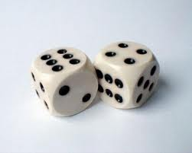
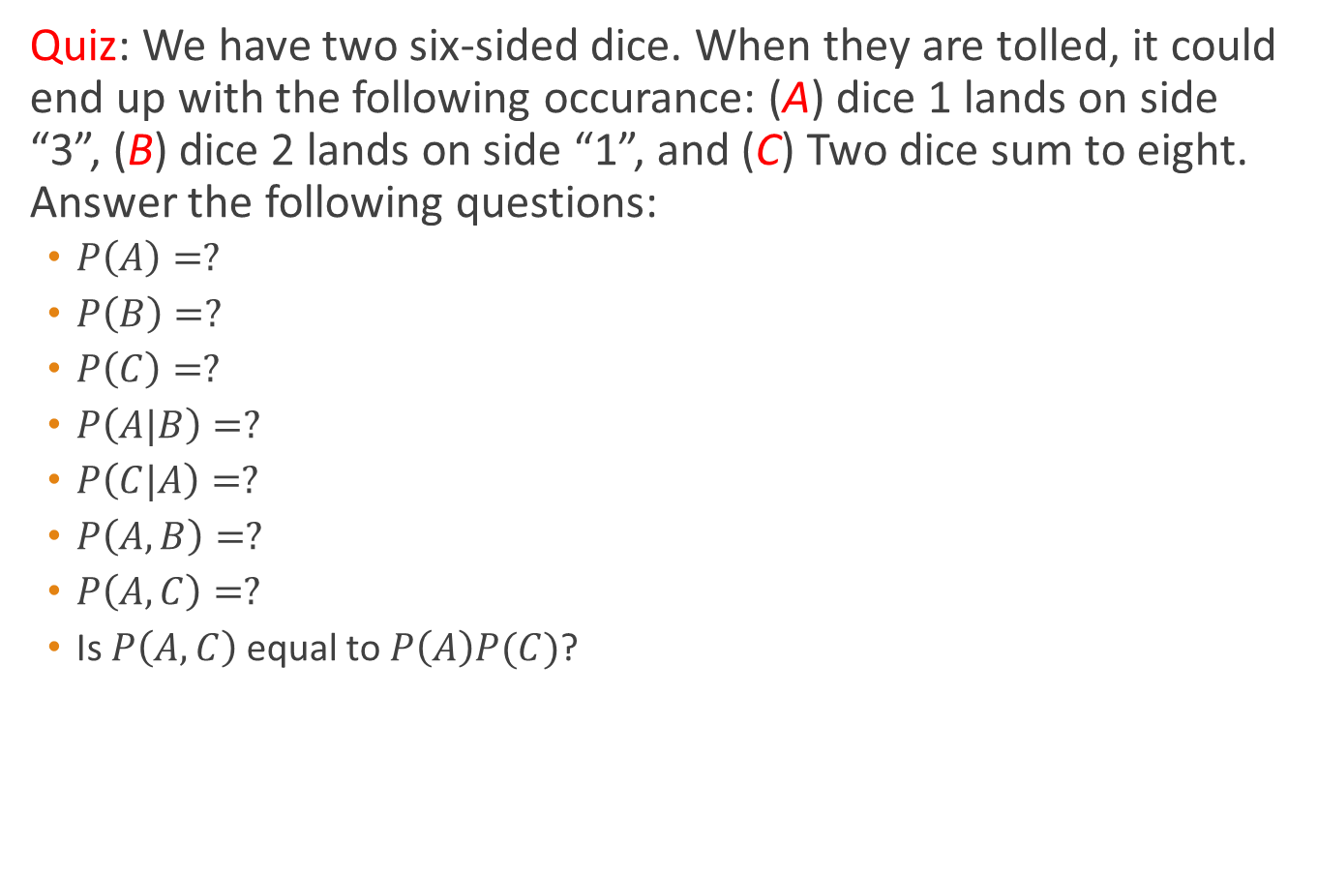
Probability Basics
Quiz: We have two six-sided dice. When they are tolled, it could end up with the following occurance: (A) dice 1 lands on side “3”, (B) dice 2 lands on side “1”, and (C) Two dice sum to eight. Answer the following questions:
$P\left(A\right)=?$
$P\left(B\right)=?$
$P\left(C\right)=?$
$P\left(A|B\right)=?$
$P\left(C|A\right)=?$
$P\left(A,B\right)=?$
$P\left(A,C\right)=?$
Is $P\left(A,C\right)$ equal to $P\left(A\right)P(C)$?

Slide 5
Probabilistic Classification
Establishing a probabilistic model for classification
Discriminative model
$$P\left(c | x\right) c=c_{1},…,c_{L}, x=(x_{1},…,x_{n})$$
To train a discriminative classifier regardless its probabilistic or non-probabilistic nature, all training examples of different classes must be jointly used to build up a single discriminative classifier.
Output L probabilities for L class labels in a probabilistic classifier while a single label is achieved by a non-probabilistic classifier .
Discriminative
Probabilistic Classifier

Slide 6
Probabilistic Classification
Establishing a probabilistic model for classification
Generative model (must be probabilistic)
$$P\left(c | x\right) c=c_{1},…,c_{L}, x=(x_{1},…,x_{n})$$
L probabilistic models have to be trained independently
Each is trained on only the examples of the same label
Output L probabilities for a given input with L models
“Generative” means that such a model produces data subject to the distribution via sampling.
Generative
Probabilistic Model
for Class 1
Generative
Probabilistic Model
for Class L

Slide 7
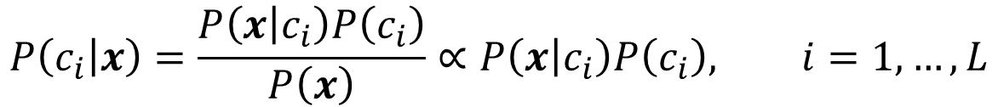
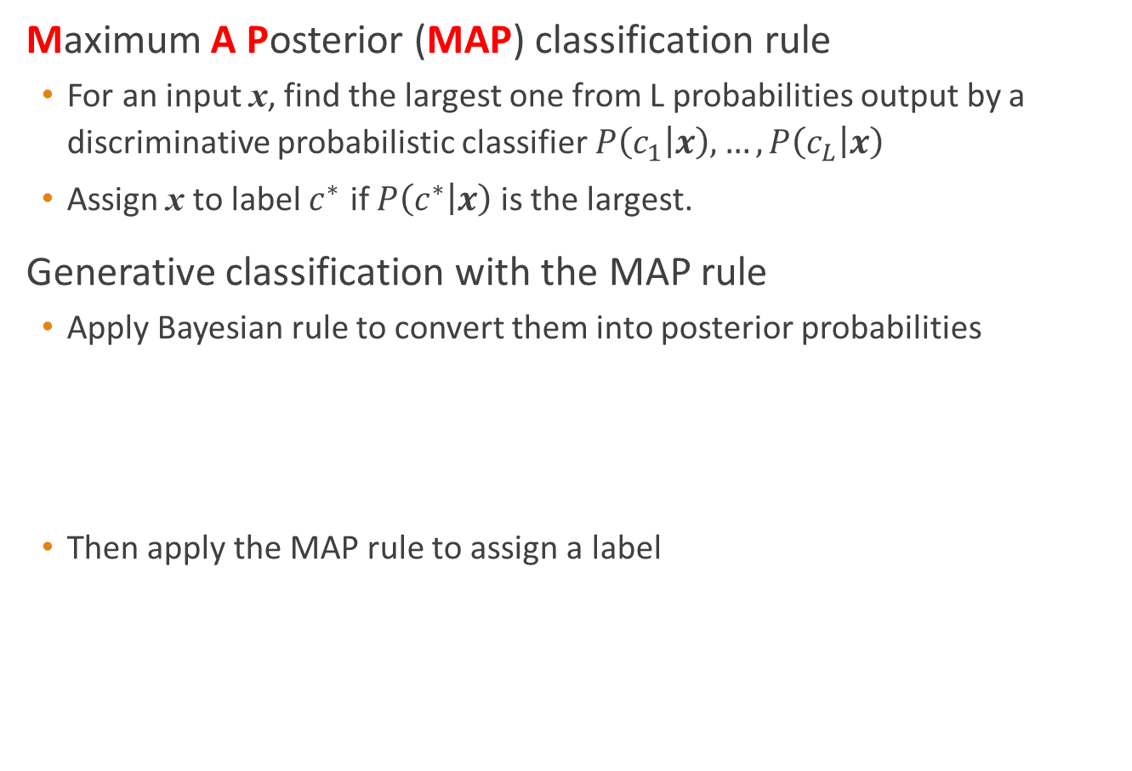
Probabilistic Classification
Maximum A Posterior (MAP) classification rule
For an input x, find the largest one from L probabilities output by a discriminative probabilistic classifier $P\left(c_{1} | x\right),…,P\left(c_{L} | x\right)$
Assign x to label $c^{∗}$ if $P\left(c^{∗} | x\right)$ is the largest.
Generative classification with the MAP rule
Apply Bayesian rule to convert them into posterior probabilities
Then apply the MAP rule to assign a label
$$P\left(c_{i} | x\right)=\frac{P\left(x | c_{i}\right)P\left(c_{i}\right)}{P\left(x\right)}∝P\left(x | c_{i}\right)P\left(c_{i}\right), i=1,…,L$$
Common factor for all L probabilities

Slide 8
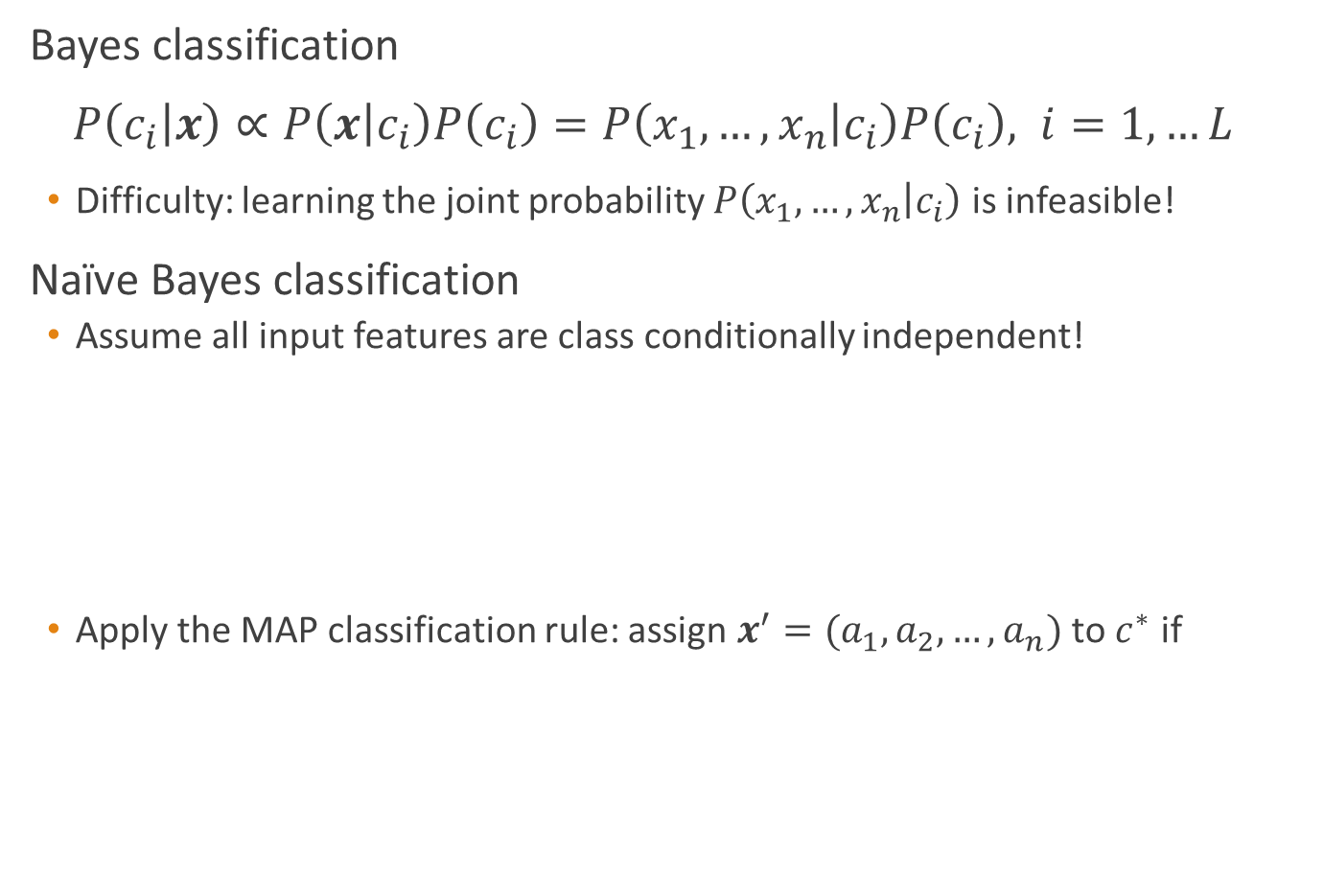
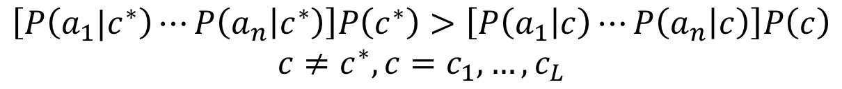

Naïve Bayes
Bayes classification
$P\left(c_{i} | x\right)∝P\left(x | c_{i}\right)P\left(c_{i}\right)=P\left(x_{1},…,x_{n} | c_{i}\right)P\left(c_{i}\right), i=1,…L$
Difficulty: learning the joint probability $P\left(x_{1},…,x_{n} | c_{i}\right)$ is infeasible!
Naïve Bayes classification
Assume all input features are class conditionally independent!
Apply the MAP classification rule: assign $x^{′}=(a_{1},a_{2},…,a_{n})$ to $c^{∗}$ if
$$P\left(x_{1},…,x_{n} | c_{i}\right)=P\left(x_{1} | c_{i}\right)P(x_{2},…,x_{n}|c_{i})$$
Applying the independence assumption
$$=P\left(x_{1} | c_{i}\right)P(x_{2}|c_{i})⋯P(x_{n}|c_{i})$$
$$\left[P\left(a_{1}|c^{∗}\right)⋯P\left(a_{n} | c^{∗}\right)\right]P\left(c^{∗}\right)>\left[P\left(a_{1} | c\right)⋯P\left(a_{n} | c\right)\right]P\left(c\right)$$
$$c≠c^{∗}, c=c_{1},…,c_{L}$$

Slide 9
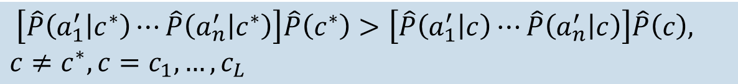

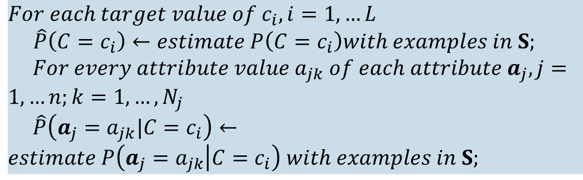
Naïve Bayes Algorithm
Naïve Bayes Algorithm (for discrete input attributes) has two phases
1. Learning Phase: Given a training set $S$,
Output: conditional probability tables; for $x_{j}$, $N_{j}×L$ elements
2. Test Phase: Given an unknown instance $x^{′}=[a_{1}^{′},a_{2}^{′},…,a_{n}^{′}]$,
Look up tables to assign the label $c^{∗}$ to $x^{′}$ if
Learning is easy, just create probability tables.
$$For each target value of c_{i}, i=1,…L$$
$\hat{P}\left(C=c_{i}\right)←estimate P\left(C=c_{i}\right)with examples in S;$
$For every attribute value a_{jk} of each attribute a_{j}, j=1,…n;k=1,…,N_{j}$
$\hat{P}\left(a_{j}=a_{jk}|C=c_{i}\right)←estimate P\left(a_{j}=a_{jk} | C=c_{i}\right) with examples in S;$
$\left[\hat{P}\left(a_{1}^{′} | c^{∗}\right)⋯\hat{P}\left(a_{n}^{′} | c^{∗}\right)\right]\hat{P}\left(c^{∗}\right)>\left[\hat{P}\left(a_{1}^{′} | c\right)⋯\hat{P}\left(a_{n}^{′} | c\right)\right]\hat{P}\left(c\right),$
$$c≠c^{∗}, c=c_{1},…,c_{L}$$
Classification is easy, just multiply probabilities

Slide 10
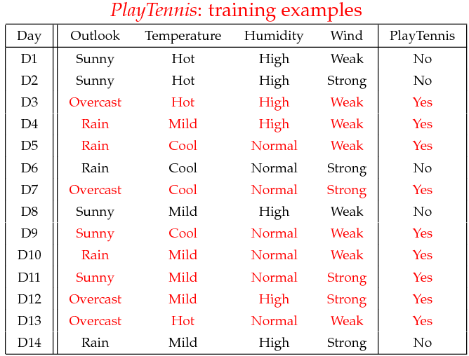
Tennis example

Slide 11
Tennis example
The learning phase
P(Play=Yes) = 9/14
P(Play=No) = 5/14
We have four variables, we calculate for each we calculate the conditional probability table
Outlook | Play=Yes | Play=No
Sunny | 2/9 | 3/5
Overcast | 4/9 | 0/5
Rain | 3/9 | 2/5
Temperature | Play=Yes | Play=No
Hot | 2/9 | 2/5
Mild | 4/9 | 2/5
Cool | 3/9 | 1/5
Humidity | Play=Yes | Play=No
High | 3/9 | 4/5
Normal | 6/9 | 1/5
Wind | Play=Yes | Play=No
Strong | 3/9 | 3/5
Weak | 6/9 | 2/5

Slide 12
Formulation of a Classification Problem
Given the data as found in last slide
Find for a new point in space (vector of values) to which group it belongs (classify)

Slide 13

The test phase for the tennis example
Given a new instance of variable values,
$x^{′}$=(Outlook=Sunny, Temperature=Cool, Humidity=High, Wind=Strong)
Given calculated Look up tables
Use the MAP rule to calculate Yes or No
P(Outlook=Sunny|Play=Yes) = 2/9
P(Temperature=Cool|Play=Yes) = 3/9
P(Huminity=High|Play=Yes) = 3/9
P(Wind=Strong|Play=Yes) = 3/9
P(Play=Yes) = 9/14
P(Outlook=Sunny|Play=No) = 3/5
P(Temperature=Cool|Play==No) = 1/5
P(Huminity=High|Play=No) = 4/5
P(Wind=Strong|Play=No) = 3/5
P(Play=No) = 5/14
P(Yes|x’): [P(Sunny|Yes)P(Cool|Yes)P(High|Yes)P(Strong|Yes)]P(Play=Yes) = 0.0053
P(No|x’): [P(Sunny|No) P(Cool|No)P(High|No)P(Strong|No)]P(Play=No) = 0.0206
Given the fact P(Yes|x’) < P(No|x’), we label x’ to be “No”.

Slide 14
Issues Relevant to Naïve Bayes
1. Violation of Independence Assumption
2. Zero conditional probability Problem

Slide 15

Issues Relevant to Naïve Bayes
1. Violation of Independence Assumption
For many real world tasks,
Nevertheless, naïve Bayes works surprisingly well anyway!
$$P\left(x_{1},…,x_{n} | c_{i}\right)≠P\left(x_{1} | c_{i}\right)⋯P(x_{n}|c_{i})$$

Slide 16

Issues Relevant to Naïve Bayes
2. Zero conditional probability Problem
Such problem exists when no example contains the attribute value
In this circumstance, during test
For a remedy, conditional probabilities are estimated with Laplace smoothing
$$a_{j}=a_{jk}→ \hat{P}\left(a_{j}=a_{jk} | {C=c}_{i}\right)=0$$

Slide 17
Conclusion
Naïve Bayes is based on the independence assumption
Training is very easy and fast; just requiring considering each attribute in each class separately
Test is straightforward; just looking up tables or calculating conditional probabilities with normal distributions
Naïve Bayes is a popular generative classifier model
Performance of naïve Bayes is competitive to most of state-of-the-art classifiers even if in presence of violating the independence assumption
It has many successful applications, e.g., spam mail filtering
A good candidate of a base learner in ensemble learning
Apart from classification, naïve Bayes can do more…

